Slide 1
FRONT END PROJECT
ONLINE FOOD ORDERING SYSTEM
BY,
JEEVA RAJAGOPAL

Slide 2
OBJECTIVE
Develop a system that will allow customers to place their food order online and provide them with feedback, a generic image of the meal, a list of sweets, cakes, cool drinks and ice creams and cost information.

Slide 3
INTRODUCTION
The Online Ordering System can be defined as a simple and convenient way for customers to purchase food online, without having to go to the restaurant. This system is enabled by the internet – it is the internet that connects the restaurant or the food company on one hand, and the customer on other hand.

Slide 4
LANGUAGES USED
BOOT
STRAP
HTML
JAVA SCRIPT
CSS

Slide 5
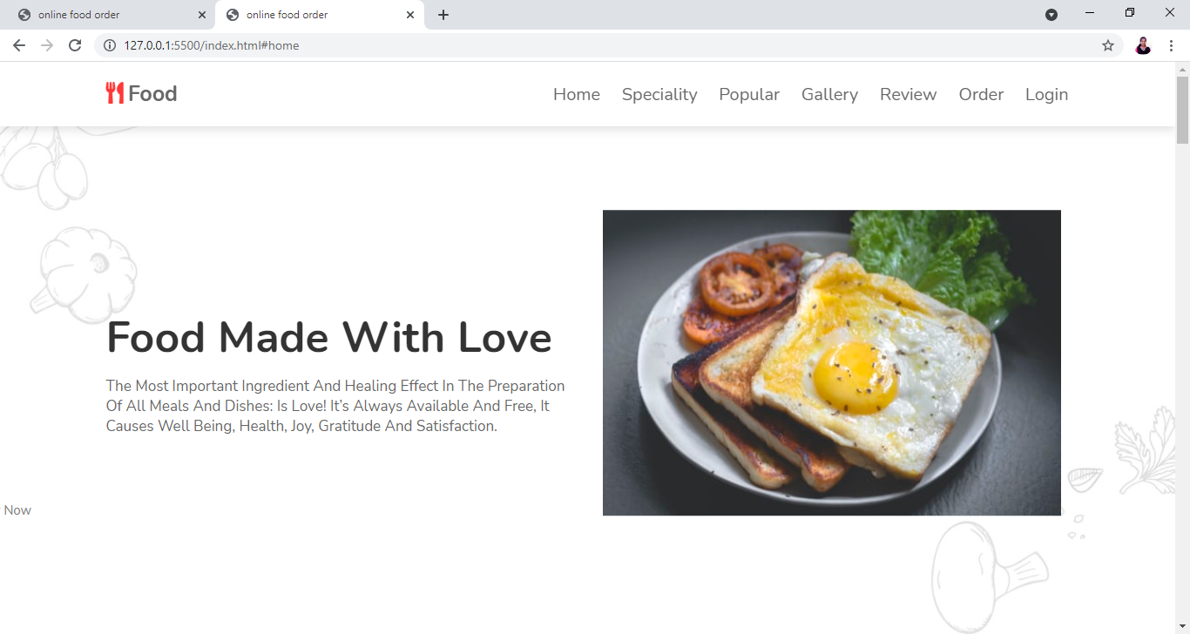
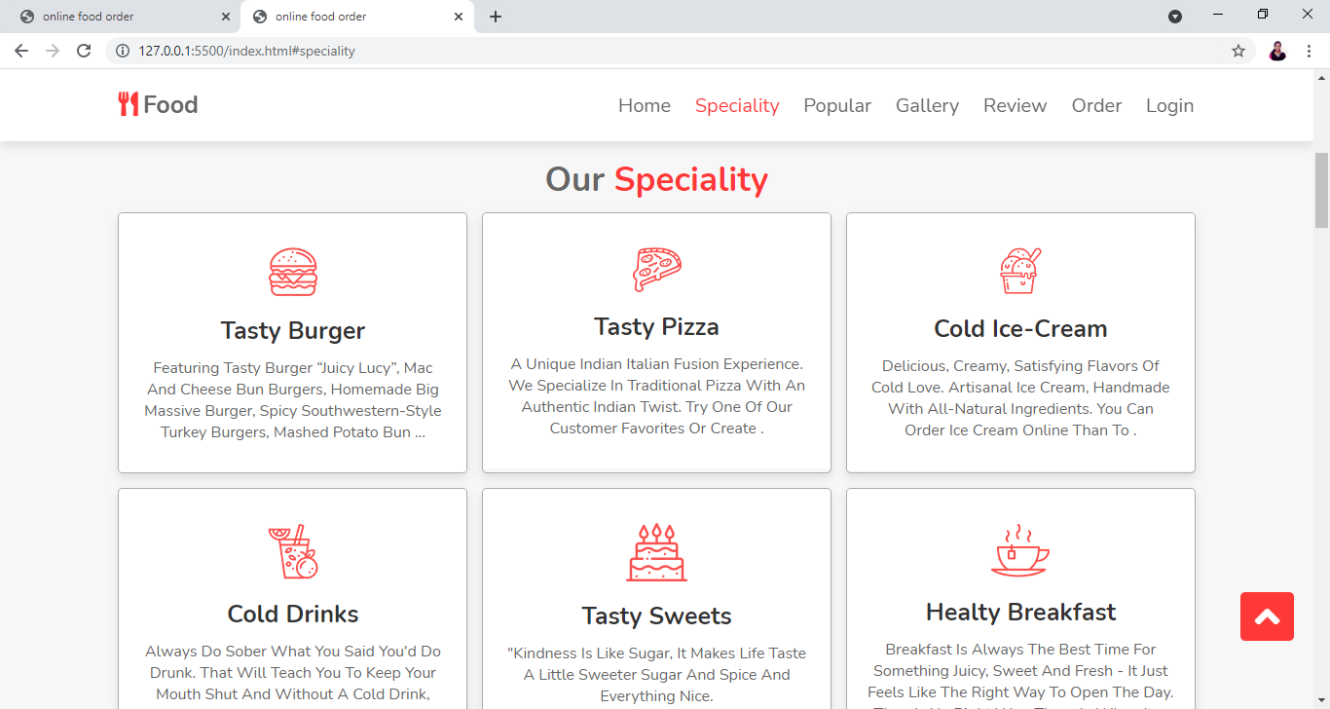
SCREENSHOTS
HOME PAGE
SPECIALITY

Slide 6
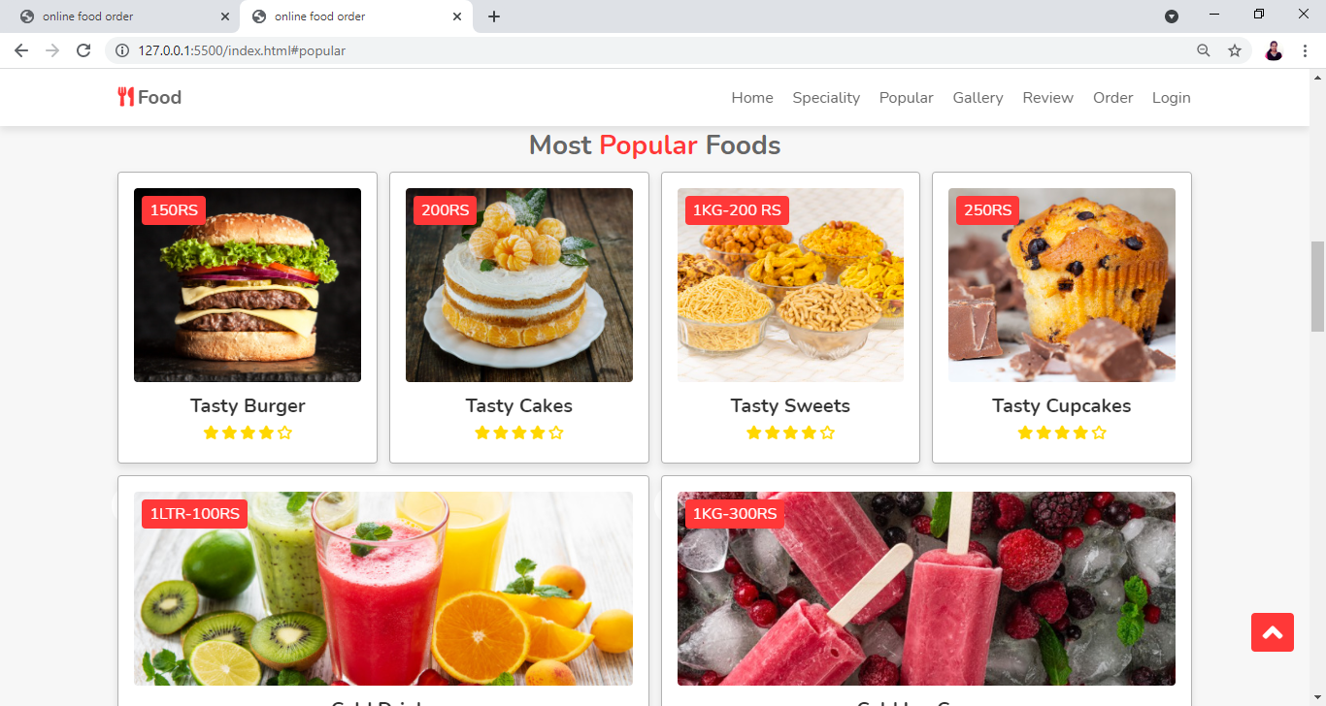
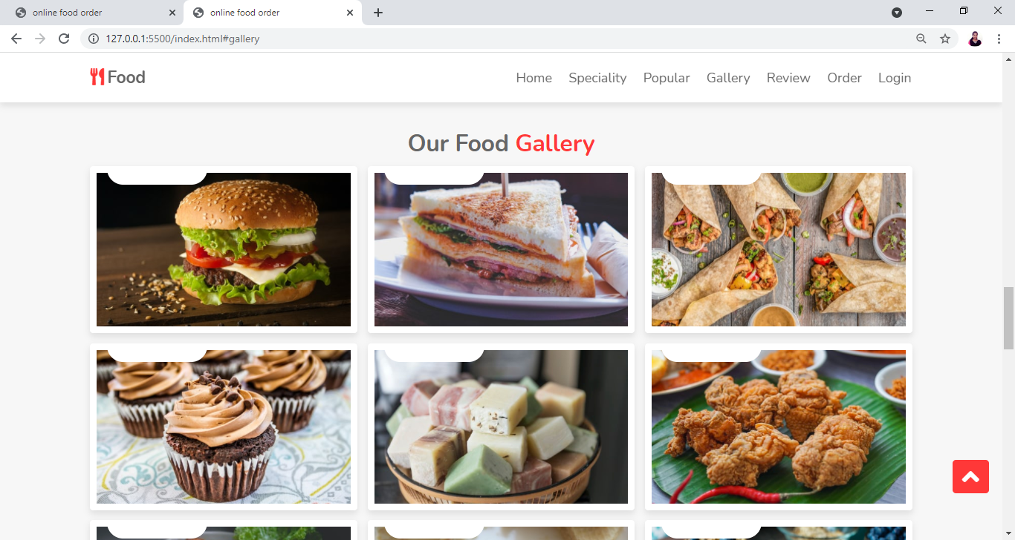
SCREENSHOTS
POPULAR FOODS
GALLERY

Slide 7
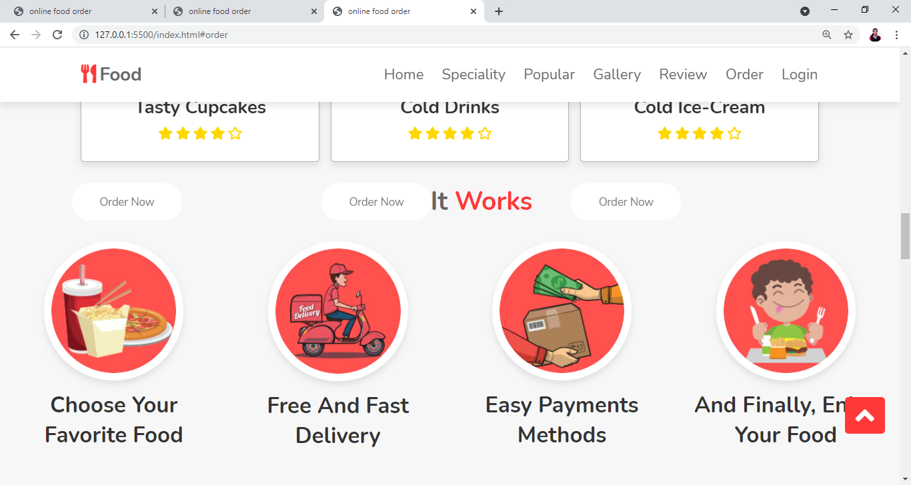
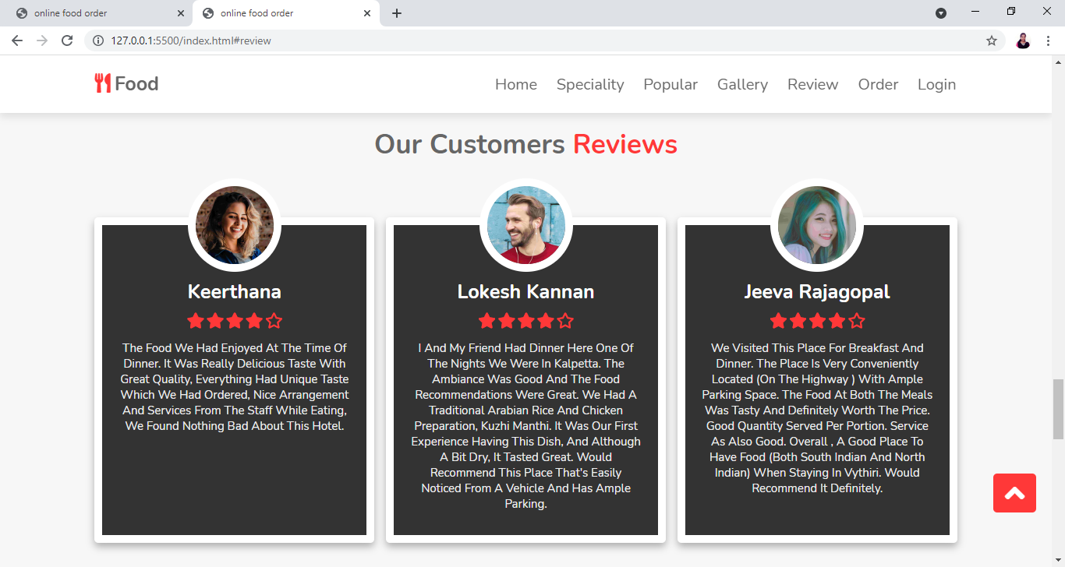
SCREENSHOTS
HOW ITS WORK
REVIEWS

Slide 8
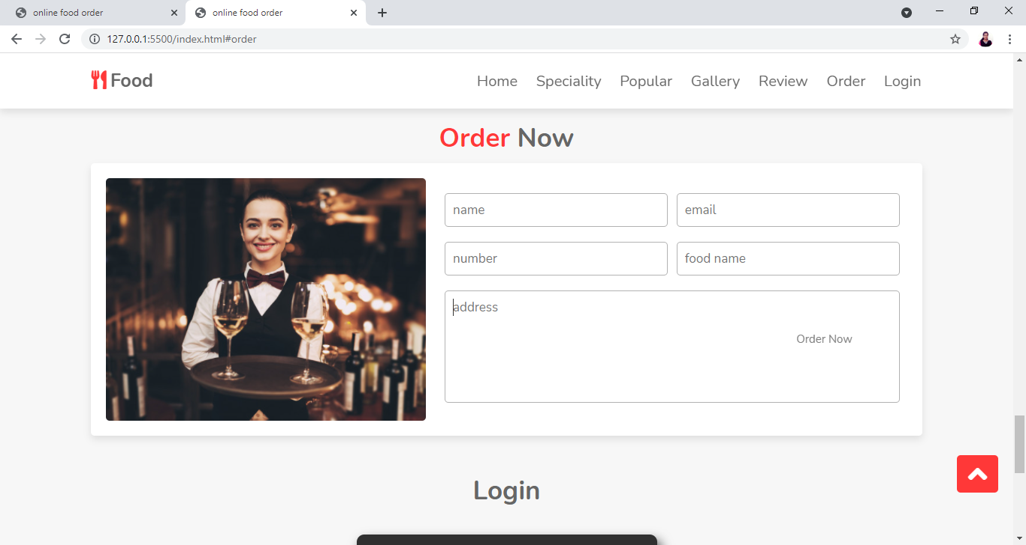
ORDER NOW

Slide 9
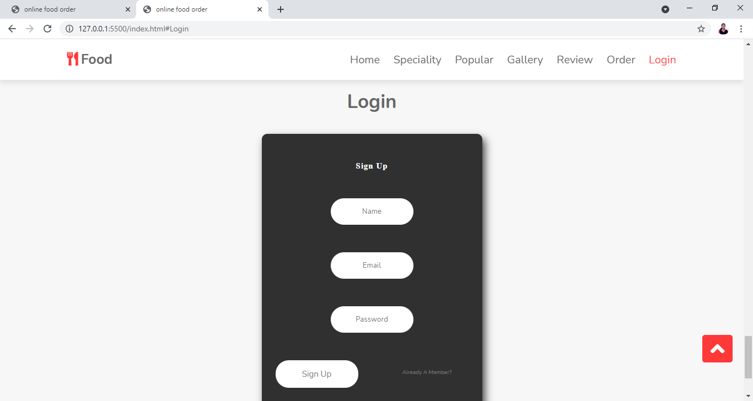
LOGIN PAGE

Slide 10


